Slide 1
Lecture 9 Intro to Statistics in R
Kristin Privitera-Johnson
FISH 552 Introduction to R

Slide 2
Outline
Probability distributions
Exploratory data analysis
Linear models

Slide 3
Probability distributions in R
R includes a comprehensive set of probability distributions that can be used to simulate and model data
If the function for the probability model is named xxx
pxxx: evaluate the cumulative distribution P(X ≤ x)
dxxx: evaluate the probability mass/density function f(x)
qxxx: evaluate the quantile q, the smallest x such that P(X ≤ x) > q
rxxx: generate random values from the model xxx
Mass for discrete r.v., density for continuous

Slide 4
Probability distributions in R
Distribution | R name | Additional arguments
beta | beta | shape1, shape2
binomial | binom | size, prob
Cauchy | cauchy | location, scale
chi-squared | chisq | df
exponential | exp | rate
F | f | df1, df2
gamma | gamma | shape, scale
geometric | geom | prob
hypergeometric | hyper | m,n, k
lognormal | lnorm | meanlog, sdlog
logistic | logis | location, scale
negative binomial | nbinom | size, prob
normal | norm | mean,sd
Poisson | pois | lambda
Student’s t | t | df
uniform | unif | min, max
Weibull | weibull | shape, scale
Wilcoxon | wilcox | m,n

Slide 5
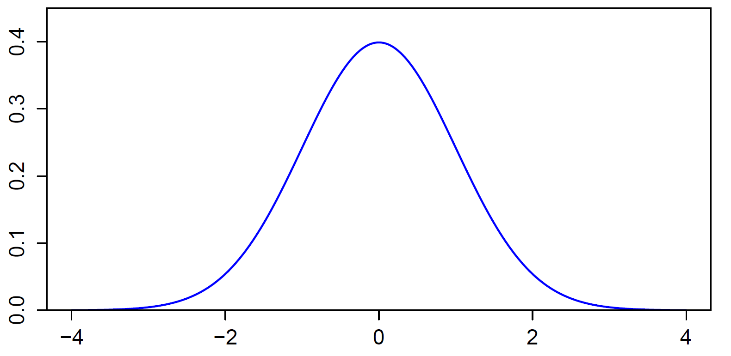
Standard normal distribution
What are axes here?

Slide 6
Functions for normal distribution
Values of x for different quantiles
qnorm(p, mean=0, sd=1, lower.tail=TRUE, log.p=FALSE)
> quants <- qnorm(c(0.01,0.025,0.05,0.95,0.975,0.99))
> round(quants,2)
[1] -2.33 -1.96 -1.64 1.64 1.96 2.33
Probability of observing value x or smaller
pnorm(q, mean=0, sd=1, lower.tail=TRUE, log.p=FALSE)
> pnorm(quants)
[1] 0.010 0.025 0.050 0.950 0.975 0.990

Slide 7
Standard normal
Density
dnorm(x, mean = 0, sd = 1, log.p = FALSE)
> dnorm(quants)
[1] 0.02665214 0.05844507 0.10313564 0.10313564
[5] 0.05844507 0.02665214
Generating random normal variables
rnorm(n, mean = 0, sd = 1)
> rnorm(n=10)
[1] 1.91604284 0.41294905 -0.23959763 0.21590614
[5] 1.32797569 -0.19704848 -0.04746724 0.92903915
[9] 0.37813679 0.45441023
The height (“density”) of the normal curve
Rerun and you get different values

Slide 8
Random number generation
Computers generate pseudorandom numbers using a sequence of specially chosen numbers and algorithms
Each sequence of numbers starts at a random seed with values in .Random.seed
By default the random sequence is initialized based on the start time of the program
For repeatable pseudorandom sequences first call set.seed(seed) with seed = any integer between −2147483648 (-2³¹) and 2147483647 (2³¹-1)

Slide 9
Simulating data
When simulating data or working with random numbers, it is usually a good idea to use set.seed() and save the script detailing which number was used
This ensures you can exactly repeat your results
> set.seed(100)
> rnorm(3)
[1] -0.50219235 0.13153117 -0.07891709
> rnorm(3)
[1] 0.8867848 0.1169713 0.3186301
> set.seed(100)
> rnorm(3)
[1] -0.50219235 0.13153117 -0.07891709
> rnorm(3)
[1] 0.8867848 0.1169713 0.3186301

Slide 10
The sample() function
To generate random numbers from discrete sets of values
With or without replacement
Equal probability or weighted probability
This is the function that underlies some modern statistical techniques
Resampling
Bootstrapping

Slide 11
Using sample()
Roll 10 dice
> sample(1:6,size=10,replace=T)
[1] 2 3 5 5 2 3 3 5 4 5
Flip a coin 10 times
> sample(c("H","T"), size=10, replace=T)
[1] "H" "T" "T" "T" "H" "T" "T" "H" "H" "T"
Pick 5 cards from a deck of cards
> cards <- paste(rep(c("A",2:10,"J","Q","K"),4),
c("Club","Diamond","Heart","Spade"))
> sort(cards) #check that this worked!
> sample(cards,5)
[1] "7 Club" "6 Diamond" "J Heart" "7 Spade"
[5] "K Heart"

Slide 12
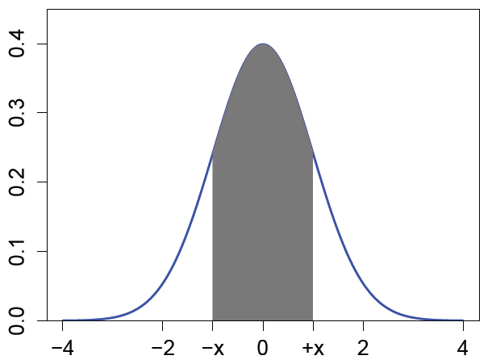
Hands-on exercise 1
Generate 100 random normal numbers with mean 80 and standard deviation 10. What proportion of these are ≥2 standard deviations from the mean?
Select 6 numbers from a lottery containing 56 balls numbered 1 to 56. Go to http://www.walottery.com/WinningNumbers/
Did you win?
For a standard normal random
variable, find the number x
such that P(-x ≤ X ≤ x) = 0.24
(use symmetry, see diagram)
find x
so that shaded area is 0.24

Slide 13
Exploratory data analysis
Important starting point in any analysis
Numerical summaries that quickly tell you things about your data
summary()
boxplot()
fivenum()
sd()
range()
Visualizing your data is usually much more informative, find which built-in plot is useful

Slide 14
Recall the iris data
> iris
Sepal.Length Sepal.Width Petal.Length Petal.Width Species
1 5.1 3.5 1.4 0.2 setosa
2 4.9 3.0 1.4 0.2 setosa
3 4.7 3.2 1.3 0.2 setosa
...
51 7.0 3.2 4.7 1.4 versicolor
52 6.4 3.2 4.5 1.5 versicolor
...
101 6.3 3.3 6.0 2.5 virginica
102 5.8 2.7 5.1 1.9 virginica

Slide 15
pairs()
Quickly produces a matrix of scatterplots
> pairs(iris[,1:4])
> pairs(iris[,1:4],
main = "Edgar Anderson's Iris Data",
pch = 21,
bg = rep(c("red", "green3", "blue"),
table(iris$Species)) )
final two lines: table() returns the number of occurrences of each species, so this repeats "red" 50 times, "green3" 50 times and "blue" 50 times, to assign these colors to the circles for each species

Slide 16
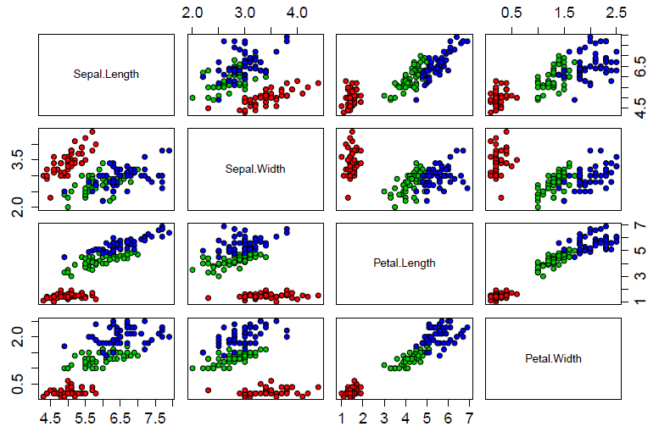

Slide 17
Histograms
Quick and easy way of seeing data shape, center, skewness, and any outliers
?hist (many options)
When values are continuous, measurements are subdivided into intervals using breakpoints ("breaks")
Many ways of specifying breakpoints
Vector of breaks
Number of breaks
Name of a general built-in algorithm

Slide 18
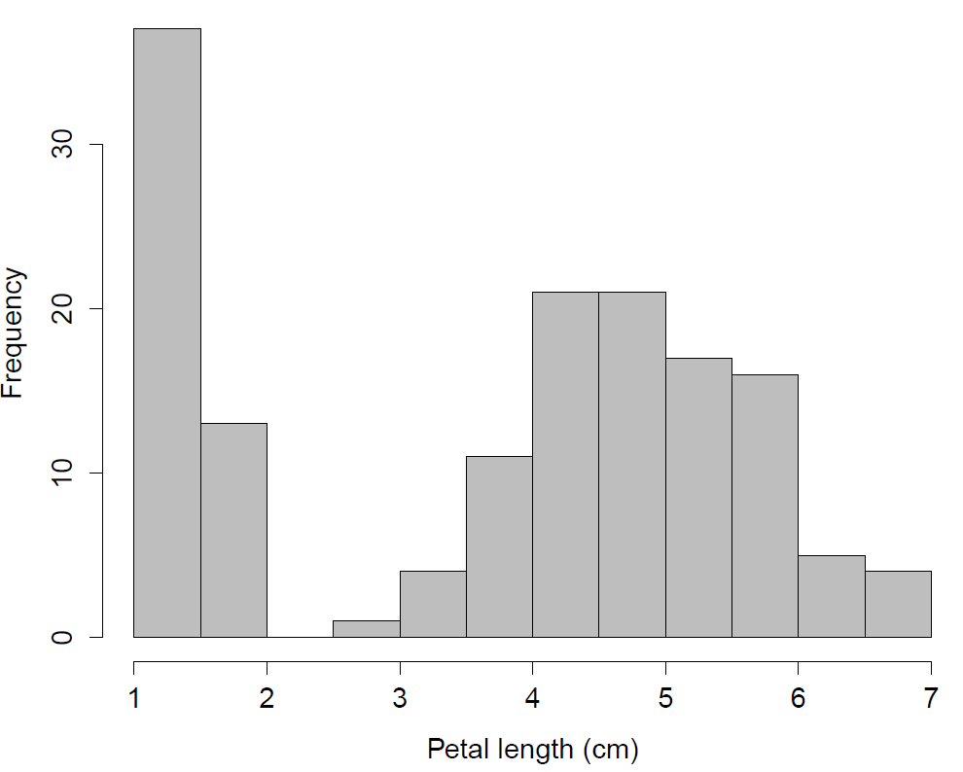
hist(iris$Petal.Length, main="", col="gray", xlab="Petal length (cm)")

Slide 19
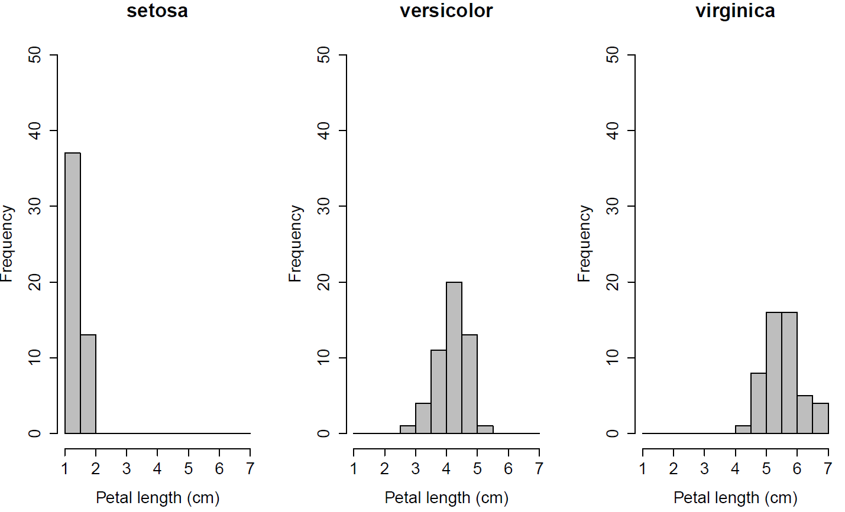
Separate plots by species

Slide 20
Adding density curves
Kernel density estimation using the density() function is a non-parametric way of estimating the underlying probability function
The higher the bandwidth the smoother will be the resulting curve
Usually best to let R choose the optimal value for the bandwidth to avoid bias
Many different kernel density methods, best to use the default for most purposes

Slide 21
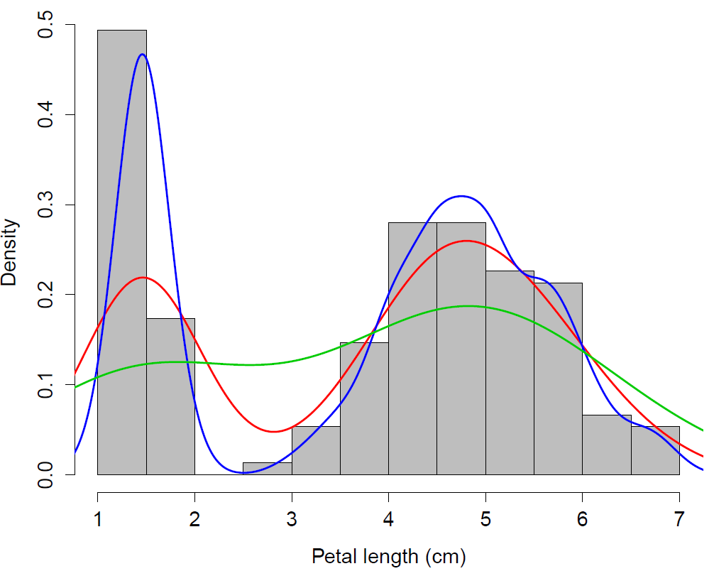
hist(iris$Petal.Length, main="", col="gray", xlab="Petal length (cm)", freq=F) lines(density(iris$Petal.Length), lwd=2, col="red") lines(density(iris$Petal.Length,adjust=0.4), lwd=2, col="blue") lines(density(iris$Petal.Length,adjust=2), lwd=2, col="green3")
Smaller
bandwidth
Default
bandwidth
Higher
bandwidth

Slide 22
Other useful plots
Plot | R function
Barplot | barplot()
Contour lines of two-dimensional distribution | contour()
Plot of two variables conditioned on the other | coplot()
Represent 3-D using shaded squares | image()
Dotchart | dotchart()
Pie chart | pie()
3-dimensional surface plot | persp()
Quantile-quantile plot | qqplot()
Stripchart | stripchart()

Slide 23
Are model assumptions met?
In the MASS library there are many functions
Are samples independent? (Sample design.)
Normally distributed?
Histograms, qq-plots: qqplot() and qqline()
Kolmogorov-Smirnov normality test: ks.test()
Shapiro-Wilk normality test: shapiro.test()
Similar variance among samples?
Boxplots
Bartlett’s test for equal variance: bartlett.test()
Fligner-Killeen test for equal variance: fligner.test()

